Slide 1
Animal Muscle Identification

Slide 2
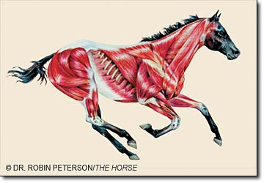
Types of Muscles
Skeletal Muscles:
Have a striped appearance, include voluntary and involuntary, attached to and moves your bones. This is a majority of the muscle tissue in your body.

Slide 3
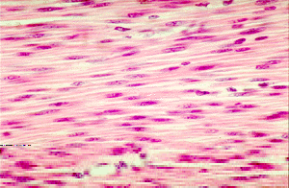
Types of Muscles
Smooth Muscles:
Involuntary muscles, found in the walls of internal organs and the blood vessels.
Notes:
Additional definitions: Flexor: decreases the angle between two bones when it contracts (biceps)
Extensors: Increases the angle between two bones when it contracts (triceps)

Slide 4
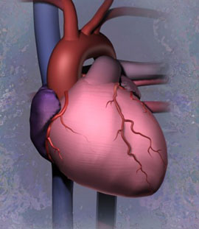
Types of Muscles…
Cardiac Muscles:
Muscles that form a network to make up the heart.

Slide 5
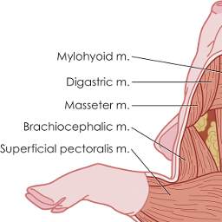
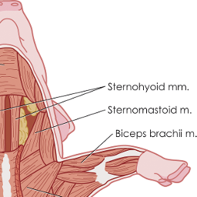
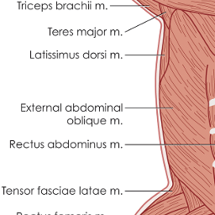
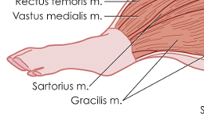
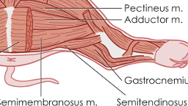
Pig muscle Anatomy Diagram

Slide 6
Head and neck Muscles
Masseter
Elevates the mandible
Brachiocephalic
Helps to protract the arm
Trapezius
Helps to keep the scapula in place and move it forward and backward.
Notes:
https://www.inkling.com/read/dissection-guide-atlas-fetal-pig-smith-schenk-3rd/chapter-3/head-and-neck

Slide 7
Pig muscle Anatomy Diagram

Slide 8
Pig muscle anatomy diagram
Notes:
http://10nvue.wix.com/human-anatomy---physiology#!__page-2

Slide 9
Arm and shoulder muscles
Latissimus Dorsi
Major retractor muscle of the arm
Deltoid
Helps to protract the upper arm
Deep Pectoral
Adducts the limb and pulls the limb caudally
Triceps Brachii
Extends the elbow and flexes the shoulder
Biceps Brachii
Flexor of the forearm
Notes:
http://books.google.com/books?id=LaaLNfY6gB8C&pg=PA23&lpg=PA23&dq=arm+and+shoulder+muscles+of+a+pig&source=bl&ots=X2LKsJW9mh&sig=Xg3AsH38t_PFpsJGd8vjAHYKOjA&hl=en&sa=X&ei=1KoAVMeHJI7HggSdroHgBA&ved=0CCwQ6AEwBQ#v=onepage&q=ar

Slide 10
Pig muscle Anatomy Diagram

Slide 11
Pig muscle anatomy diagram
Notes:
https://animalplanet.wikispaces.com/IV.+Ferko+and+Spencer+Muscles

Slide 12
Pelvis and thigh muscles
Tensor Fasciae Latae
Helps to extend the shanks, as well as to protract the thigh at the hip joint.
Semitendinosus
Assists the biceps femoris in thigh retraction and shank flexion
Gastrocnemius and Soleus
Extend the foot
Notes:
http://books.google.com/books?id=LaaLNfY6gB8C&pg=PA23&lpg=PA23&dq=arm+and+shoulder+muscles+of+a+pig&source=bl&ots=X2LKsJW9mh&sig=Xg3AsH38t_PFpsJGd8vjAHYKOjA&hl=en&sa=X&ei=1KoAVMeHJI7HggSdroHgBA&ved=0CCwQ6AEwBQ#v=onepage&q=ar

Slide 13
Pig muscle Anatomy Diagram

Slide 14
Trunk Muscles
External/internal oblique
Compresses the abdomen and flexes the trunk
Rectus abdominis
Supports the abdominal wall and ventrally flexes the abdomen
Notes:
http://books.google.com/books?id=LaaLNfY6gB8C&pg=PA23&lpg=PA23&dq=arm+and+shoulder+muscles+of+a+pig&source=bl&ots=X2LKsJW9mh&sig=Xg3AsH38t_PFpsJGd8vjAHYKOjA&hl=en&sa=X&ei=1KoAVMeHJI7HggSdroHgBA&ved=0CCwQ6AEwBQ#v=onepage&q=ar
http://books.google.com/books?id=JFvJAgAAQBAJ&pg=PA34&dq=what+does+the+external+oblique+muscles+do+in+a+pig&hl=en&sa=X&ei=-LMAVNX4FJDHgwSUxIGgDg&ved=0CCsQ6AEwAg#v=onepage&q=what%20does%20the%20external%20oblique%2
http://books.google.com/books?id=-PsZaBufEM0C&pg=PA166&dq=what+does+the+rectus+abdominis+muscles+do+in+a+pig&hl=en&sa=X&ei=c7YAVMuVN87OggSJ4oGIAw&ved=0CDcQ6AEwAQ#v=onepage&q=what%20does%20the%20rectus%20abdominis%20muscles%20do%20in%20a%20pig&f=false

Slide 15
Pig muscle Anatomy Diagram

Slide 16
Cattle muscle anatomy diagram

Slide 17
Head and Neck muscles
Masseter
Located in the cheek, its function is to move the jaw and teeth.
Brachiocephalicus
Aids in the movement of the leg and shoulder. Also, acts as a lateral flexor in the neck.
Trapezius
Aids in movement of the scapula.
Notes:
amandawbio.files.wordpress.com/2008/05/cow_dentition11.doc
http://www.vetmed.vt.edu/education/curriculum/vm8644/equineneck/Definitions/brachiocephalicus.html
http://bovine.unl.edu/eng/glos.jsp

Slide 18
Cattle muscle anatomy diagram

Slide 19
Arm and shoulder muscles
Deltoid
Abducts the arm.
Triceps Brachii
Extends the elbow.
Biceps Brachii
Flexes the arm and forearm.
Brachialis
Flexes the elbow.
Latissimus Dorsi
Flexes the shoulder.
Deep Pectoral
Extends the shoulder joint, elevates the trunk when limb advances, and retracts limb.
Notes:
http://bovine.unl.edu/eng/glos.jsp
http://www.meddean.luc.edu/lumen/MedEd/grossanatomy/dissector/muscles/delt.htm
http://medical-dictionary.thefreedictionary.com/biceps+brachii
http://www.aw-bc.com/info/martini6e/assets/pdf/chapter11.pdf

Slide 20
Cattle muscle anatomy diagram

Slide 21
Trunk, Pelvis, and thigh muscles
Gastrocnemius
Extends the hock or flexes the stifle joint.
Internal/External Abdominal Oblique
Compresses the abdomen and flexes the trunk.
Tensor Fasciae Latae
Flexes the hip joint, and extends the stifle joint.
Middle Gluteal
Extends the hip and abducts the limb.
Biceps Femoris
Extends the hip, stifle, and hock joints, and flexes the stifle when the hind foot is off the ground.
Semitendinosus
Extends the hip, stifle and hock joint, and flexes the stifle joint when the hindfoot is lifted from the ground.
Notes:
http://bovine.unl.edu/eng/glos.jsp
http://www.onlineveterinaryanatomy.net/sites/default/files/original_media/presentation/asset_8703_Anatomy%20of%20the%20bovine%20hindlimb.pdf

Slide 22
Cattle muscle anatomy diagram

Slide 23
Sheep muscle anatomy diagram
24—
Tensor Fasciae Latae
3–Trapezius
18—
Latissimus Dorsi
22—
Middle Gluteal
20—
Internal Abdominal Oblique
1— Masseter
2—
Brachiocephalicus
21—
External Abdominal Oblique
26—
Biceps Femoris
8— Deltoideus
6—
Deep Pectoral
27—
Semitendinosus
10—
Brachialis
28—
Gastrocnemius
Notes:
http://www.infovets.com/books/smrm/A/A030.htm

Slide 24
Head and Neck muscles
Masseter
Elevates the jaw to help aid in the process of chewing.
Trapezius
Rotates, elevates, and retracts scapula.
Brachiocephalicus
Aids in the movement of the leg and shoulder.
Notes:
http://www.meddean.luc.edu/lumen/MedEd/grossanatomy/dissector/muscles/trap.htm
http://www.vetmed.vt.edu/education/curriculum/vm8644/equineneck/Definitions/brachiocephalicus.html

Slide 25
Sheep muscle anatomy diagram
24—
Tensor Fasciae Latae
3–Trapezius
18—
Latissimus Dorsi
22—
Middle Gluteal
20—
Internal Abdominal Oblique
1— Masseter
2—
Brachiocephalicus
21—
External Abdominal Oblique
26—
Biceps Femoris
8— Deltoideus
10—
Brachialis
6—
Deep Pectoral
28—
Gastrocnemius
Notes:
http://www.infovets.com/books/smrm/A/A030.htm

Slide 26
Arm and shoulder muscles
Deltoideus
Moves and stabilizes the shoulder joint.
Deep Pectoral
Adducts the limb and stabilizes shoulder joint
Latissimus dorsi
Extends, adducts, and medially rotates arm
Brachialis
Flexes the elbow
Notes:
https://www.kenhub.com/en/library/anatomy/the-deltoid-muscle
http://www.meddean.luc.edu/lumen/meded/grossanatomy/dissector/mml/lat.htm

Slide 27
Sheep muscle anatomy diagram
24—
Tensor Fasciae Latae
3–Trapezius
18—
Latissimus Dorsi
20—
Internal Abdominal Oblique
22—
Middle Gluteal
1— Masseter
2—
Brachiocephalicus
21—
External Abdominal Oblique
26—
Biceps Femoris
8— Deltoideus
10—
Brachialis
6—
Deep Pectoral
28—
Gastrocnemius
Notes:
http://www.infovets.com/books/smrm/A/A030.htm

Slide 28
Trunk, pelvis, and thigh muscles
Internal/External Abdominal Oblique
Flexes abdomen
Tensor Fasciae Latae
Abducts hip
Middle Gluteal
Extends hip and abducts limb
Gastrocnemius
Flexes the knee.
Biceps Femoris
Flexes and rotates the knee
Notes:
http://thewellnessdigest.com/internal-and-external-obliques-origin-insertion-action-and-innervation/
http://www.meddean.luc.edu/lumen/meded/grossanatomy/dissector/mml/tfl.htm
http://cal.vet.upenn.edu/projects/grossanat/largemenu/hplvldmuscle.htm

Slide 29
Sheep muscle anatomy diagram
24—
Tensor Fasciae Latae
3–Trapezius
18—
Latissimus Dorsi
22—
Middle Gluteal
20—
Internal Abdominal Oblique
1— Masseter
2—
Brachiocephalicus
21—
External Abdominal Oblique
26—
Biceps Femoris
8— Deltoideus
10—
Brachialis
6—
Deep Pectoral
28—
Gastrocnemius
Notes:
http://www.infovets.com/books/smrm/A/A030.htm

